Slide 1

Feasibility Studies
System analysis & design
IDM Negombo – K.P. I. Shenesh Perera

Slide 2
What is a feasibility study?
It is an analysis of economical, technical and legal considerations.
Understanding issues with existing systems
Understanding the functions of existing systems
Generally identifying how the problem can be solved
Notes:
A feasibility study is an analysis that takes all of a project's relevant factors into account including economic, technical, legal, and scheduling considerations to ascertain the likelihood of completing the project successfully.
Project managers use feasibility studies to discern the pros and cons of undertaking a project before they invest a lot of time and money into it. Feasibility studies also can provide a company's management with crucial information that could prevent the company from entering blindly into risky businesses.
A feasibility study is simply an assessment of the practicality of a proposed plan or project.
As the name implies, these studies ask: "Is this project feasible?
Do we have the people, tools, technology, and resources necessary for this project to succeed?“
Will we get the estimated profit from doing this?
Is it a risk on the company budget if we take this project?

Slide 3
Why is a feasibility study important?
Assists business development
Gives a rough idea of what needs to be solved
Prevents a company from taking on a project that is too much to handle.
Prepares the analysts for analysis
Notes:
Feasibility studies are important to business development. They can allow a business to address where and how it will operate; identify potential obstacles that may impede its operations, and recognize the amount of funding it will need to get the business up and running.
Feasibility studies also can lead to marketing strategies that could help convince investors or banks that investing in a particular project or business is a wise choice.

Slide 4

A good feasibility study ensures efficiency.
There are very particular components a good feasibility study has.
Notes:
A feasibility study assesses the practicality of a proposed plan or project.
A company may conduct a feasibility study if it's considering launching a new business or adopting a new product line.
It's a good idea to have a contingency plan in case of unforeseeable circumstances, or if the original project is not feasible.
Divide your study into parts and study each part individually.

Slide 5

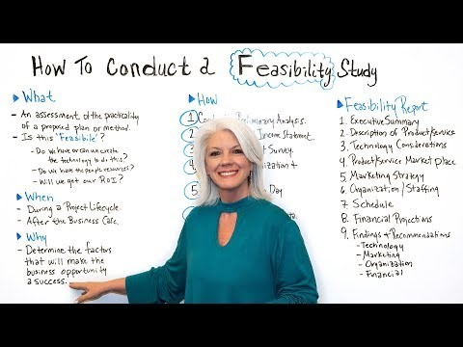
How to conduct a feasibility study?
By Project Management Videos on Youtube

Slide 6
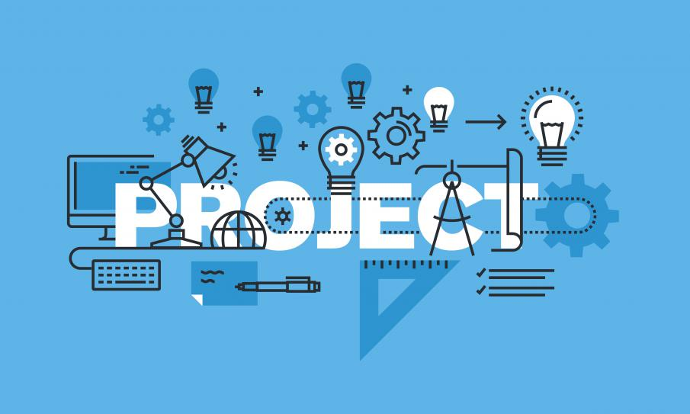

Components of a feasibility study
Figure 1.0, awfis.com, Awfis Editorial, 07/07/2017
Notes:
Notes to presenter:
What did you think at first?
What obstacles did you encounter along the way?
How did you overcome those obstacles?
What images can you add to support your process?
This SmartArt allows you to add images and text to help outline your process. If a picture is worth a thousand words, then pictures and words should help you to communicate this reflection on learning perfectly! You can always click on Insert>SmartArt to change this graphic or select the graphic and click on the Design contextual menu to change the colours.
Feel free to use more than one slide to reflect upon your process. It also helps to add some video of your process.

Slide 7
Technical Feasibility
Ensures the design is correct and meet requirements
Checking for availability of tools required to make the solution.
Ensure that the tools required are working properly
Ensures that company principles are not violated
Notes:
It is the assessment which focuses on the technical resources available to the organization. It helps organizations determine whether the technical resources meet capacity and whether the technical team is capable of converting the ideas into working systems.
Technical feasibility also involves evaluation of the hardware, software, and other technology requirements of the proposed system.
It is a very broad concept, technical feasibility involves anything from a software development project to a space travel.

Slide 8
Economic Feasibility
Checks if our budget is capable of providing a solution that satisfies user and system requirements
Checks if the company receives a significant profit in return
Ensures the worth of the solution that is provided
Outlines risk factors
Notes:
Basically , it means whether a business or a project feasible cost wise and logistically. Economics calculate economic feasibility by analyzing the costs and revenues a business would incur by undertaking a certain project.

Slide 9
Legal Feasibility
Ensures the company doesn’t end up producing something illegal.
Ensures the product lives up to legalized standards.
Ensures the security of the product in the long run.
Prevents misuse of the product
Notes:
Investigates whether any aspect of the proposed project conflicts with legal requirements like zoning laws, data protection acts, or social media laws. Let’s say an organization wants to construct a new office building in a specific location. A feasibility study might reveal the organization’s ideal location isn’t zoned for that type of business. That organization has just saved considerable time and effort by learning that their project was not feasible right from the beginning.

Slide 10
Operational Feasibility
Outlines the scope of the project
Ensures that the organizations needs are met
Outlines the requirements in order to solve existing problem
Notes:
Involves in undertaking a study to analyze and determine whether and how well the organization’s needs can be met by completing the project. Operational feasibility studies also analyze how a project plan satisfies the requirements identified in the requirements analysis phase of system development.

Slide 11
Benefits of good feasibility studies
Improves team’s focus
Identifies brand new opportunities
Provides information as to whether you should or shouldn’t do something
Identifies good reasons to take up a project
Notes:
The importance of a good feasibility study is based on organizational desire to get it right before committing resources, time, or budget.
A good feasibility study might uncover new ideas that could completely change a project’s scope. It’s best to make these determinations in advance, rather than to jump in and learning that the project just won’t work. Conducting a good feasibility study is always beneficial to the project as it gives you and other stakeholders a clear picture of the proposed project.

Slide 12

By the end of each feasibility study, you must have the following
Scope
4
Requirements
3
2
Approach
1
Evaluation
Notes:
The scope which is used to define the business problem and/or opportunity to be addressed. The scope should be definitive and to the point; rambling narrative serves no purpose and can actually confuse project participants. It is also necessary to define the parts of the business affected either directly or indirectly, including project participants and end-user areas affected by the project.
Requirements and how requirements are defined depends on the object of the project's attention. For example, how requirements are specified for a product are substantially different than requirements for an edifice, a bridge, or an information system. Each exhibits totally different properties and, as such, are defined differently. How you define requirements for software is also substantially different than how you define them for systems.
The Approach represents the recommended solution or course of action to satisfy the requirements. Here, various alternatives are considered along with an explanation as to why the preferred
solution was selected. In terms of design related projects, it is here where whole rough designs (e.g., "renderings") are developed in order to determine viability.
Evaluation examines the cost effectiveness of the approach selected. This begins with an analysis of the estimated total cost of the project. In addition to the recommended solution, other alternatives are estimated in order to offer an economic comparison.

Slide 13
The End
K.P.I. Shenesh Perera
IDM
System analysis and design
Part 2

